Slide 1

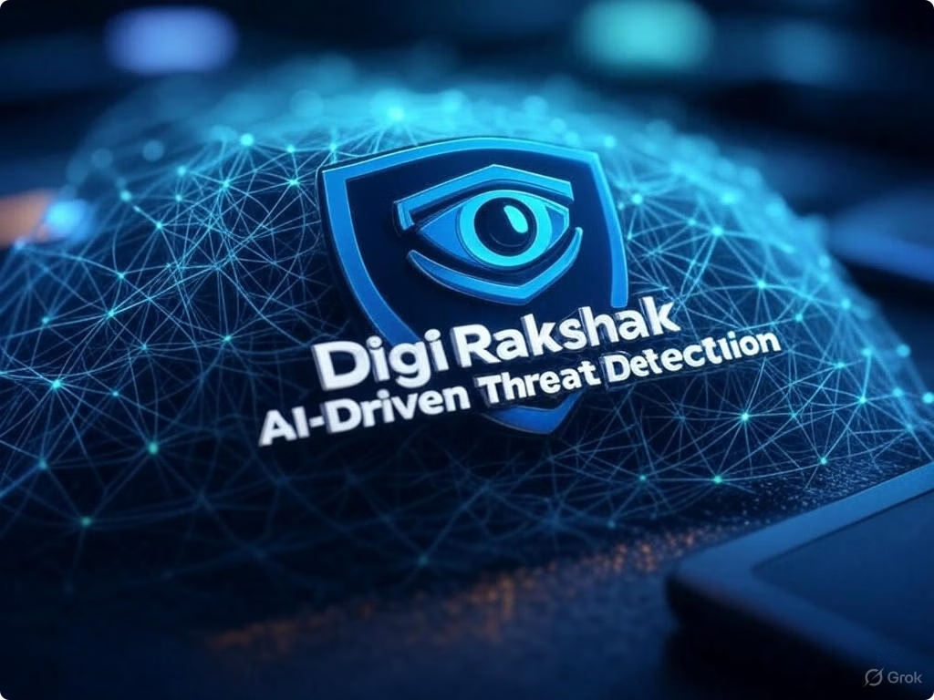
Digi Rakshak: Real-Time AI-Based Email Threat Detection System
Digi Rakshak is a cutting-edge desktop application designed to provide real-time email threat detection using artificial intelligence. It automatically scans incoming emails for phishing, spam, and malicious content without requiring manual input from the user. Operating seamlessly in the background, Digi Rakshak presents actionable insights through an intuitive dashboard, empowering users to stay protected with minimal effort.
This presentation explores the project’s objective, team structure, development plan, and unique features targeting corporate and individual users.

Slide 2
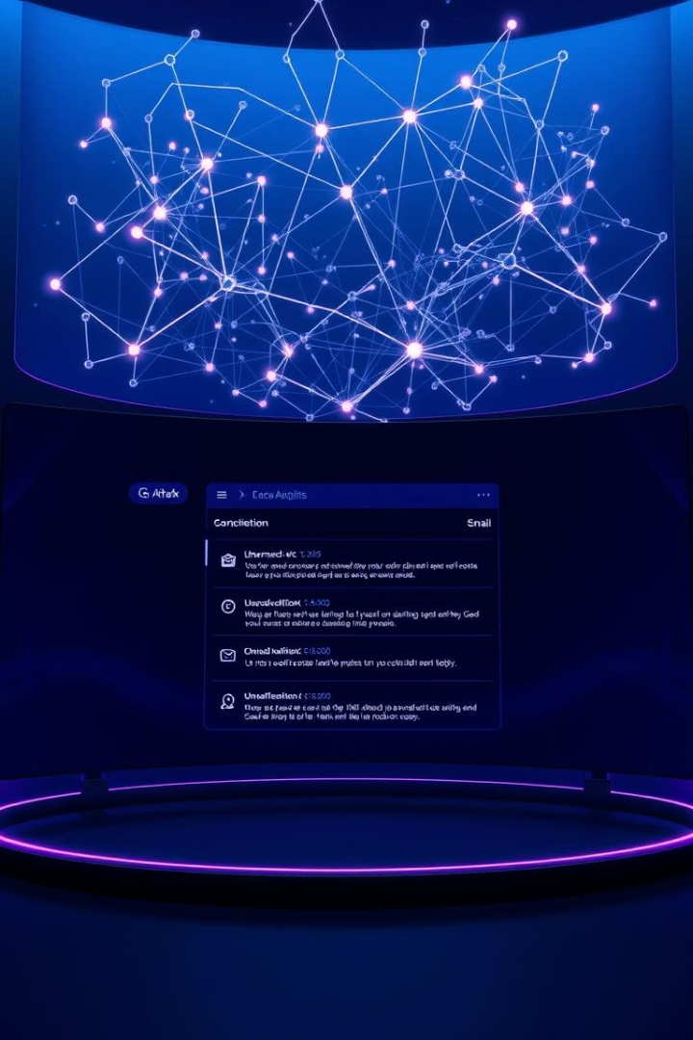
Project Objective: Autonomous Email Threat Monitoring
Real-Time Detection
AI-Driven Intelligence
Automatically monitor all incoming emails and identify threats without user intervention.
Leverages advanced machine learning models to detect phishing and spam based on content and metadata.
User-Friendly Dashboard
Displays results in a clear, actionable interface with threat scores and alerts for quick response.
The goal is a seamless and secure mechanism that operates behind the scenes, ensuring continuous protection.

Slide 3
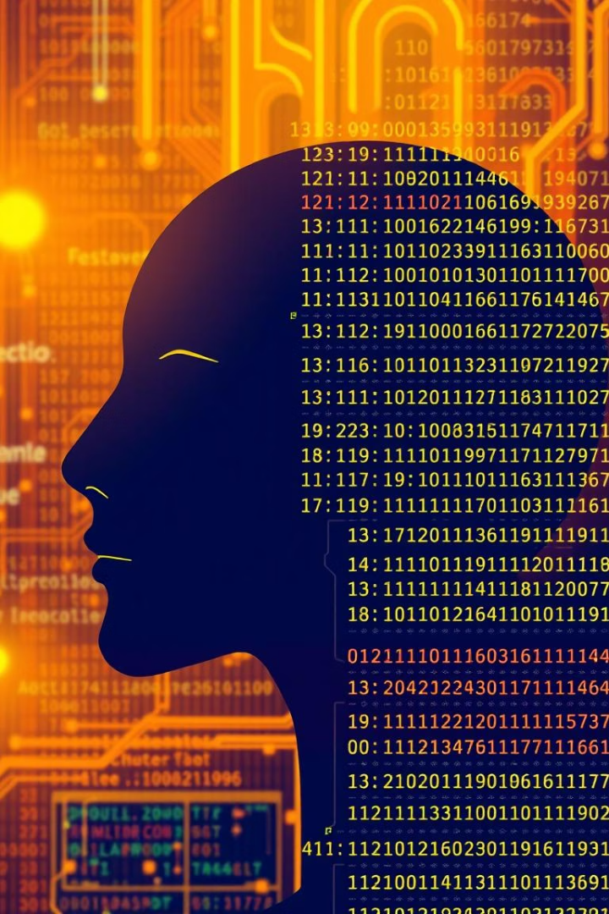
Target Users: Broad Spectrum of Professionals and Individuals
Corporate Employees
Students & Freelancers
Protect sensitive company data from sophisticated phishing attacks.
Secure personal communication and freelance projects from spam and scams.
Government & Military
Safeguard critical infrastructure and classified information against advanced threats.

Slide 4

Team Structure & Responsibilities
Role
Focus Area
Tech Stack
Project Manager
Goal definition, task assignment, progress tracking
Notion, Trello
Backend Developer
Email fetching, ML pipeline, notifications
Python, IMAP, SMTP, Scikit-learn
ML Engineer
Train and test phishing detection models
Python, Transformers, Pandas, NLTK
Frontend Developer
Create UI/UX dashboard
Electron.js, React.js
Security Analyst
Phishing pattern research, testing robustness
Google Safe Browsing, VirusTotal API
UI/UX Designer
Design intuitive 3D animated dashboard
Figma, Lottie, Three.js

Slide 5
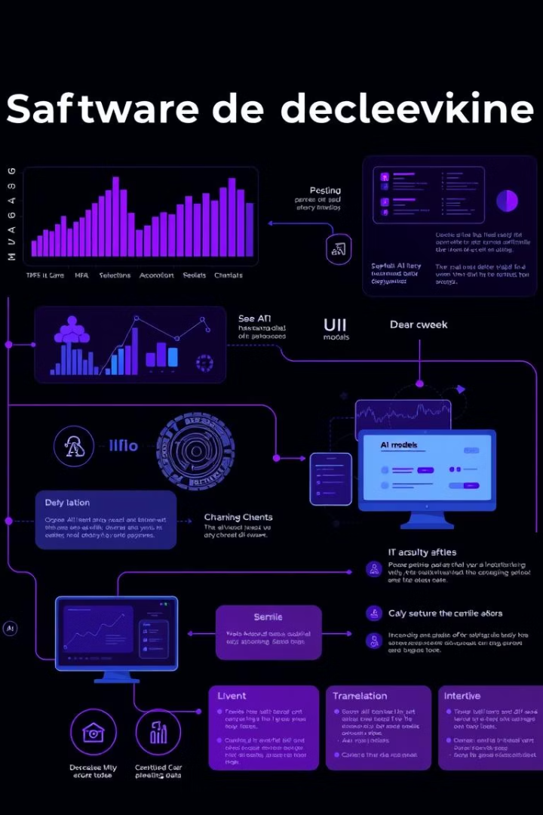




Step-by-Step Project Plan
Dataset Collection
Gather data from public phishing and spam repositories and anonymized emails for training.
ML Model Development
Clean text, extract features including TF-IDF and URL metadata, then train with Logistic Regression or BERT.
Email Fetcher Script
Connect to email inbox, fetch new messages, predict threat levels, and trigger alerts.
Dashboard & Notifications
Build an Electron & React dashboard with live alerts and toast notifications for threats.
The project is designed for modular development with clear milestones for integration and testing.

Slide 6
Unique Selling Propositions (USPs)
Real-Time & Autonomous
Explainable AI
Offline & Secure
Multi-Platform Integration
Users can see the reason behind flagged emails, enhancing trust and understanding.
Operates locally after training to protect privacy; no data leaves the user’s device.
No manual input required; continuously scans emails with immediate detection and alerts.
Compatible with Gmail, Outlook, and Yahoo accounts for extensive coverage.

Slide 7
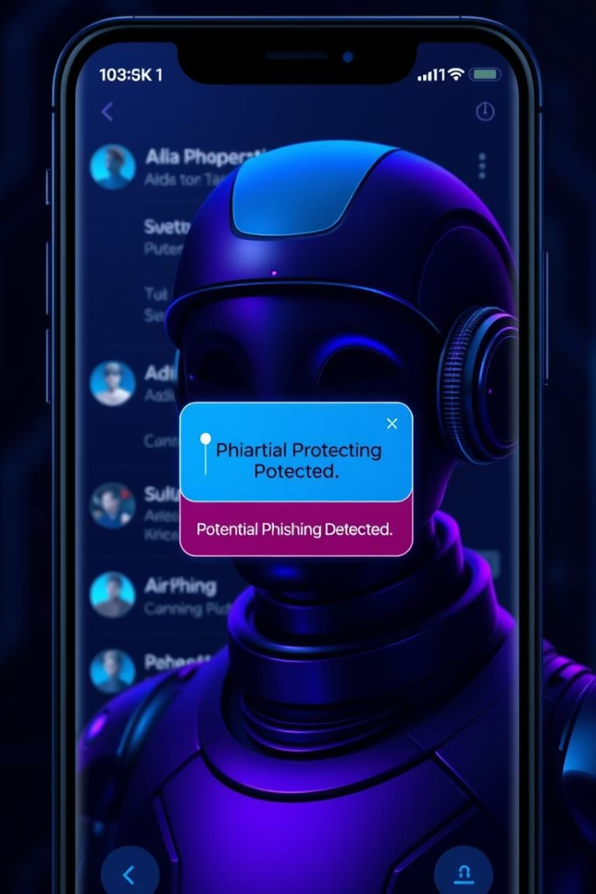
Future Scope and Enhancements
Cross-Platform Messaging
Image-Based Phishing Detection
Extend threat detection to WhatsApp and Telegram links to cover messaging apps.
Implement OCR to detect malicious images embedded in emails.
AI Voice Alerts
Provide auditory notifications for vision-impaired users for enhanced accessibility.

Slide 8

Next Steps and Resources
The next phase involves preparing and sharing the core code files, the training notebooks for the AI models, and the detailed Figma designs for the 3D animated dashboard. These resources will support development, testing, and further UI/UX refinement.
Feel free to reach out to request these files or discuss any customization needs tailored to your organization.

Slide 9
Thank you
https://github.com/aryanraghuavnshi31/Innothon2.0

